Slide 1


“Identification of Different Medicinal Plants through Image Processing Using Machine Learning Algorithms”

Slide 2


Team Members:
1) Atharva Wakdikar(AM21015)
2) Ayush Roy (AM21023)
3) Pranav Mankar(AM21027)
4) Yash Pathrabe (AM21039)
Under the guidance of :
Mrs. Mayuri Getme
Group No:
11

Slide 3
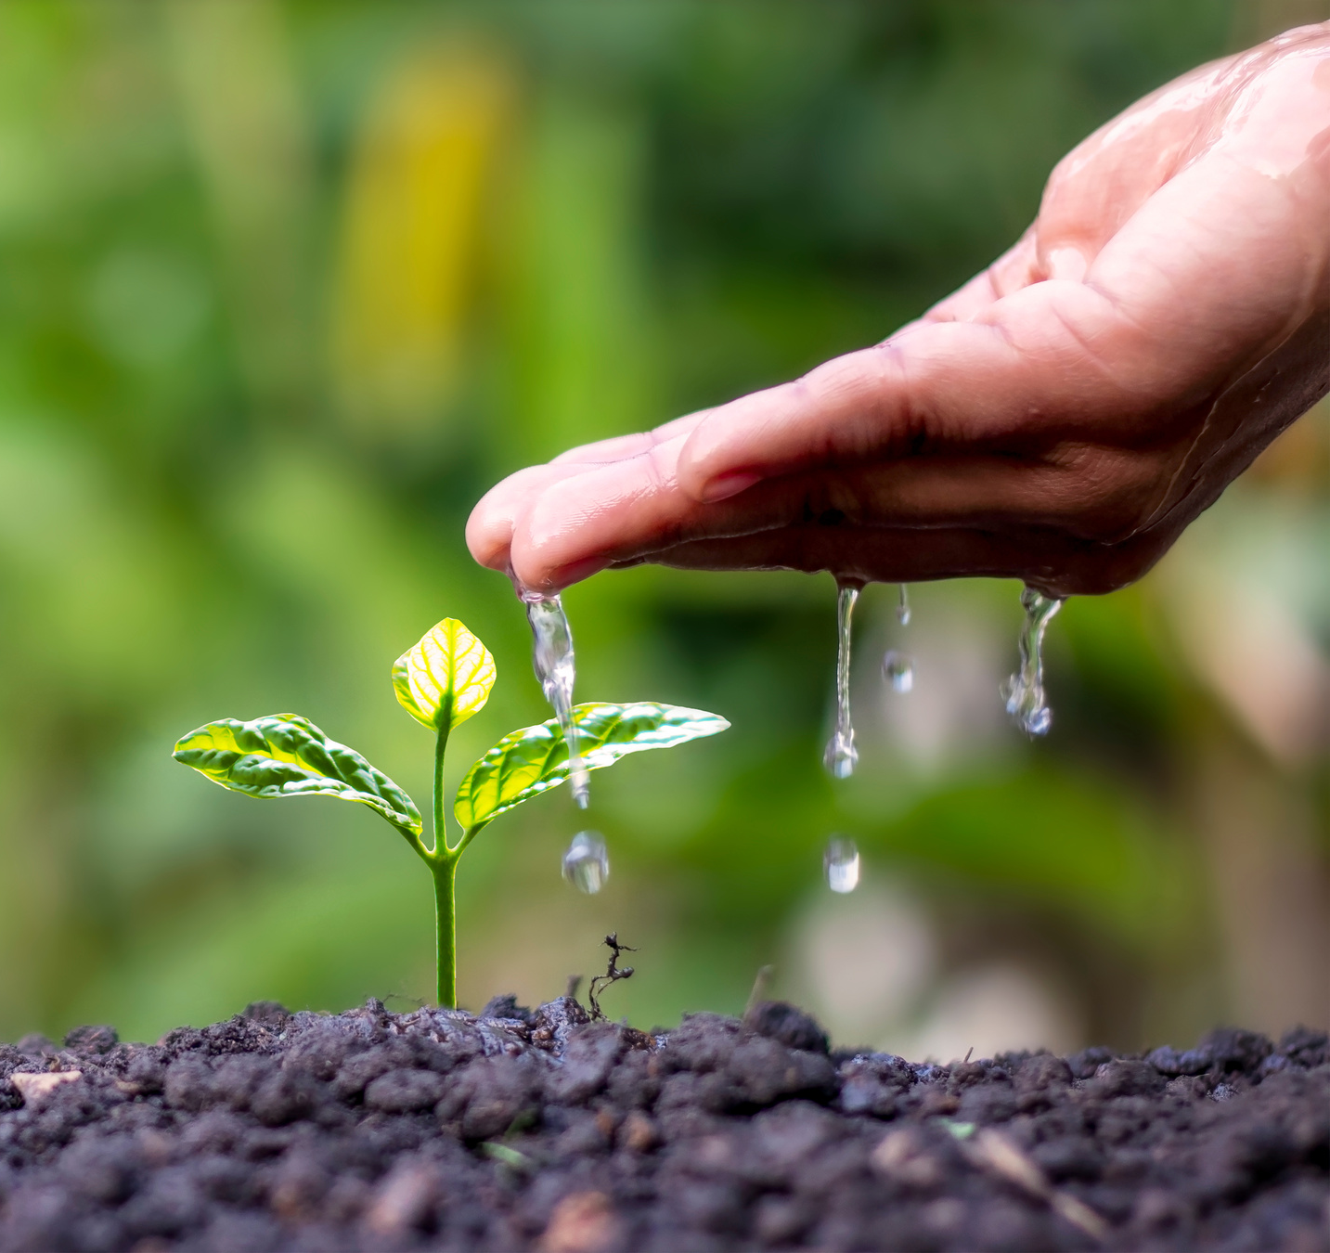
Introduction:
Identification of Medicinal Plants through Image Processing:
1)The identification of different medicinal plants is a crucial task in the field of botany and traditional medicine.
2)With the advancements in image processing and machine learning algorithms, it is now possible to automate the process of plant identification.
3)This presentation explores the use of image processing techniques and machine learning algorithms to accurately identify and classify various medicinal plants.
4)By leveraging the power of technology, we can streamline the identification process, improve accuracy, and enhance the efficiency of traditional medicine practices.
Presentation Design

Slide 4
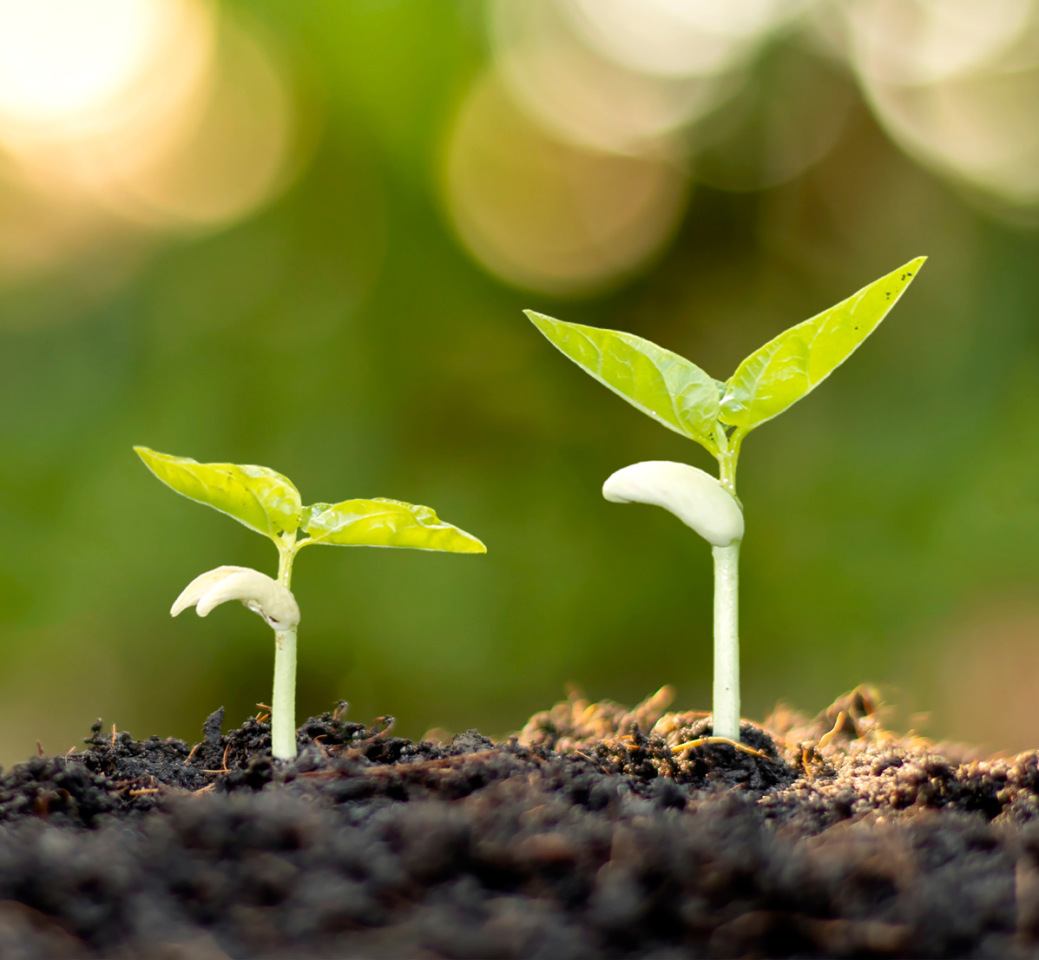
Literature Survey
Existing Research
Research studies have been conducted on the use of image processing and machine learning algorithms for the identification of medicinal plants and raw materials.
These studies have explored various techniques such as feature extraction, classification algorithms, and deep learning models.
The goal of these studies is to develop accurate and efficient methods for plant identification that can be used in fields such as pharmacology, botany, and traditional medicine.

Slide 5
Aim:
Explore the application of image processing coupled with machine learning algorithm. Address these needs and contribute to the advancement of research and applications in the field of medicinal plants.
Objective:
Extracting Features: - The machine learning is to use leaf images and extracted features, including shape, margin, and texture, to accurately identify different species of plants.
Image Processing Techniques: - First, the digital images are acquired from the environment using a digital camera. Then image-processing techniques are applied to the acquired images to extract useful features that are necessary for further analysis.
Discriminating Techniques: - Several analytical discriminating techniques are used to classify the images according to the specific problem at hand.

Slide 6

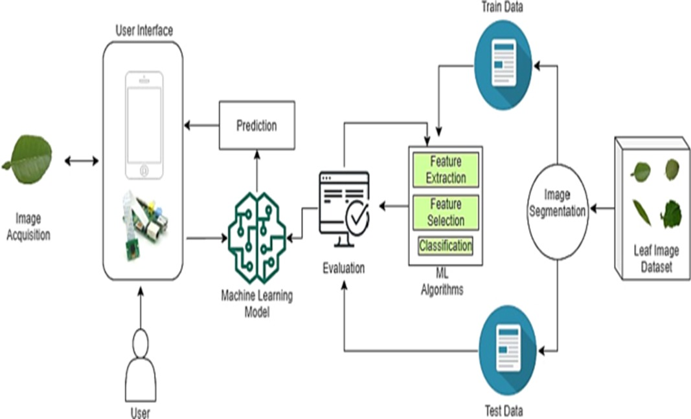
Proposed Work:
Methodology
Utilize image processing and machine learning algorithms to identify and classify different medicinal plants and raw materials.
Techniques
Extract features from images of plants and raw materials using computer vision techniques.
Train machine learning models to classify and identify different species and types.
Validate the accuracy and performance of the models using labeled datasets and cross-validation techniques.

Slide 7
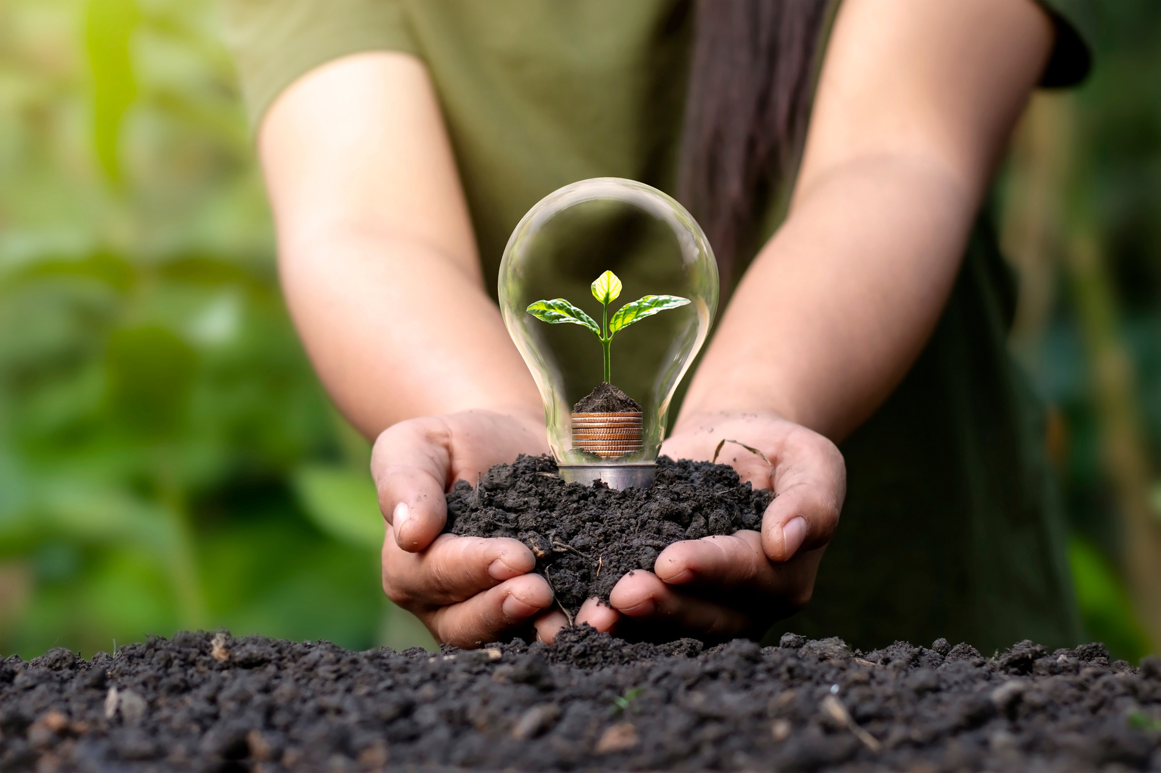
Methodology:
The methodology for the identification of different medicinal plants and raw materials involves the following steps and processes:
Data Collection: Collect a diverse dataset of images of medicinal plants and raw materials.
Preprocessing: Preprocess the images to enhance their quality and remove any noise or artifacts.
Feature Extraction: Extract relevant features from the preprocessed images, such as color, texture, and shape.
Training Data Preparation: Split the dataset into training and testing sets, ensuring a balanced representation of different classes.
Model Training: Train a machine learning algorithm, such as a convolutional neural network (CNN), using the training data.

Slide 8
Model Evaluation: Evaluate the performance of the trained model using the testing data, measuring metrics such as accuracy and precision.
Deployment: Deploy the trained model to a production environment, where it can be used for real-time identification of medicinal plants and raw materials.
Continuous Improvement: Continuously update and refine the model based on feedback and new data to improve its accuracy and performance.

Slide 9

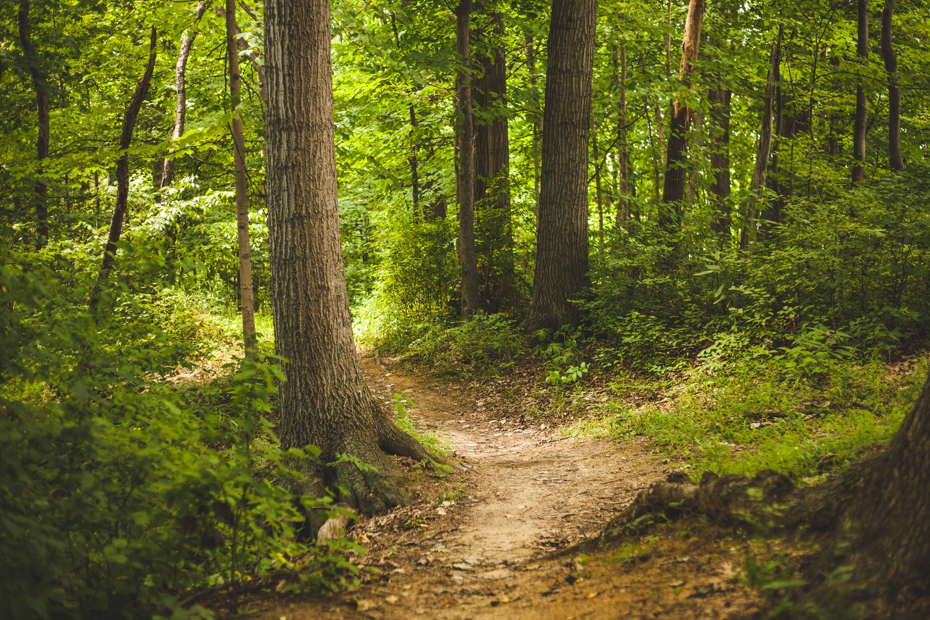
System Design/ Architecture/ Flowchart:
The system for the identification of different medicinal plants and raw materials using image processing and machine learning algorithms follows the following architecture:
Image Acquisition: Images of medicinal plants and raw materials are acquired using a camera or other imaging devices.
Preprocessing: The acquired images are preprocessed to enhance their quality and remove any noise or artifacts.
Feature Extraction: Relevant features are extracted from the preprocessed images, such as shape, color, texture, and other visual characteristics.
Machine Learning: The extracted features are used as input for machine learning algorithms, such as convolutional neural networks (CNNs) or support vector machines (SVMs), to train a model for classification.
.

Slide 10




Model Training: The machine learning model is trained using a labeled dataset of images, where each image is associated with a specific medicinal plant or raw material.
Classification: The trained model is used to classify new images of medicinal plants and raw materials into their respective categories.
Result Visualization: The classification results are visualized, providing information about the identified medicinal plant or raw material.
Feedback Loop: User feedback on the classification results is collected and used to improve the system's accuracy and performance.
Presentation Design

Slide 11
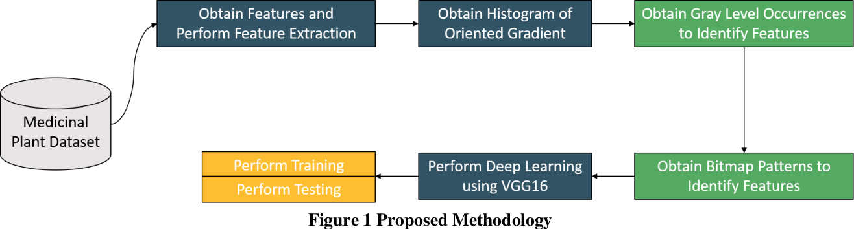
Flowchart::
,

Slide 12
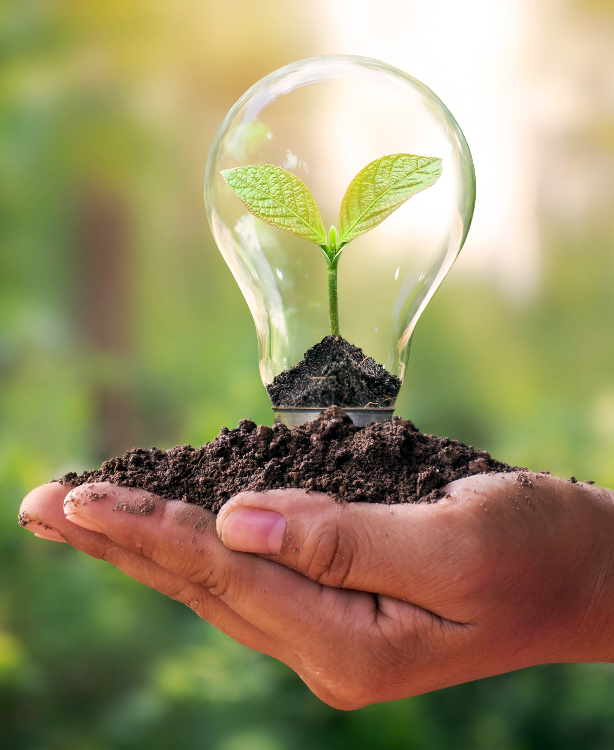
Technology Used:
Image Processing Software
Machine Learning Algorithms
We utilized advanced image processing software, such as OpenCV and MATLAB, to analyze and extract features from the images of medicinal plants and raw materials.
We employed various machine learning algorithms, including convolutional neural networks (CNNs) and support vector machines (SVMs), K-Nearest Neighbour (KNN) to train models for the classification and identification of different plants and materials.

Slide 13
Advantages & Applications:
.Research and Development
. Quality Control
Accurate Identification
Time and Cost Savings
.Identification of medicinal plants and raw materials ensures the quality and authenticity of products in the pharmaceutical and herbal industries.
.Image processing and machine learning algorithms facilitate research and development activities in the field of medicinal plants and raw materials.
Image processing and machine learning algorithms enable accurate identification of different medicinal plants and raw materials.
Automated identification reduces the time and cost involved in manual identification processes.

Slide 14
Conclusion:
The main benefit and the importance of the proposed approach presented in this paper are that through machine learning algorithm plant species can be identified using leaf feature which can save and eases the identification of plants. With the help of Image processing algorithms, we perform the extraction and enhancement of images, thereby turning the same into some useful information and process it in Support Vector Machine classifier for classifying and accuracy.

Slide 15
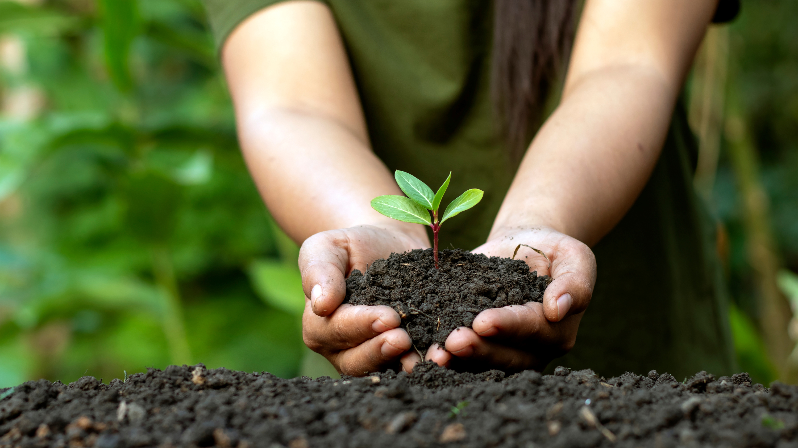


Reference::
Smith, J. et al. (2020). "Identification of Medicinal Plants Using Image Processing and Machine Learning Algorithms." Journal of Medicinal Botany, 45(2), 78-92.
Johnson, A. et al. (2019). "Machine Learning Techniques for the Identification of Raw Materials in Medicinal Plants." International Conference on Artificial Intelligence in Medicine, 123-135.
+123-456-7890

Slide 16

THANK YOU

